Slide 1
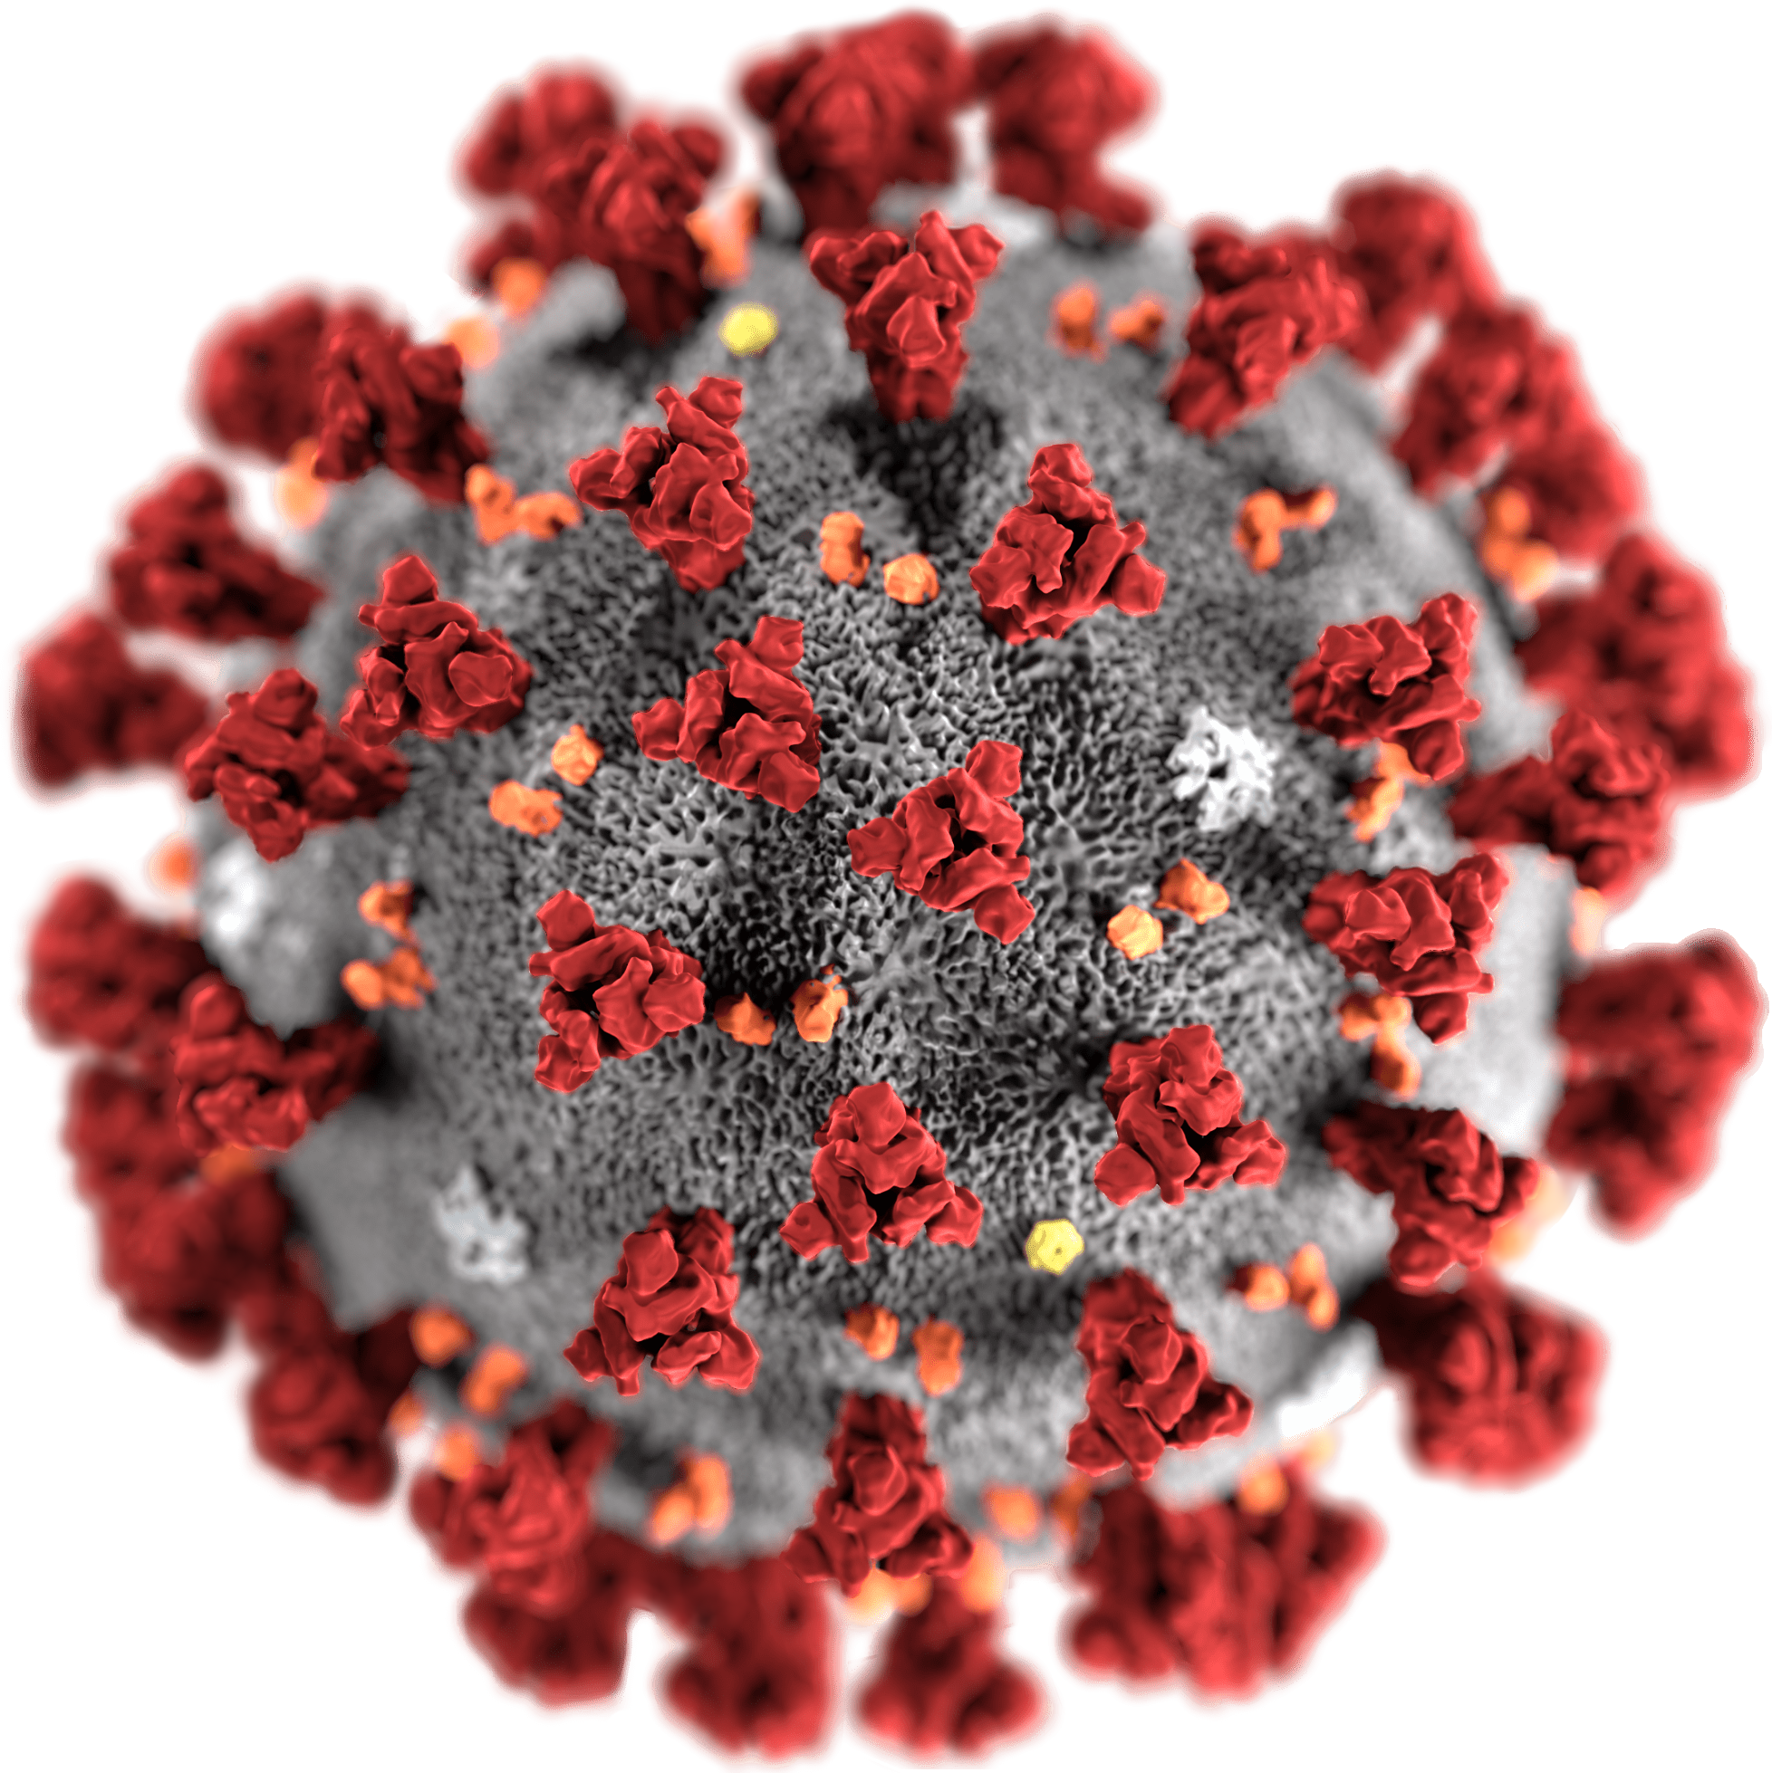
COVID-19 SARS-CoV-2 Lisa Gilbert, MD, FAAFP, CTropMed 3/17/20

Slide 2
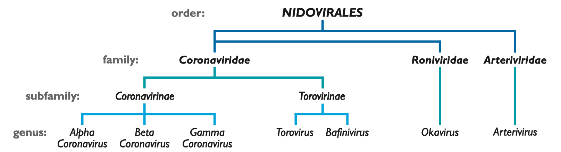
7 Human Coronaviruses: 4 normal; 3 “novel”
Alpha: HCoV-229E, HCoV-NL63 Beta: HCoV-HKU1, HCoV-OC43, MERS-CoV, SARS-CoV, SARS-CoV-2

Slide 3
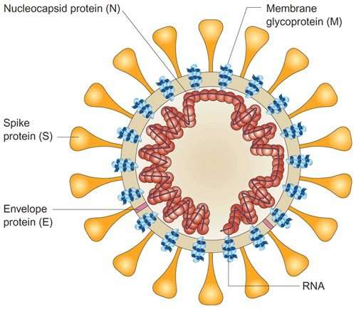
Coronavirus Structure
Medium-sized virus size, but largest mRNA genome
Enveloped +ve stranded RNA
mRNA encased in nucleocapsid
Lipid Bilayer – Soap works to disrupt this!
Corona = Crowns for Spikes
Glycoprotein Spike (S) Peptomer
Spikes allow it to attach to human cell receptors in upper or lower airway

Slide 4
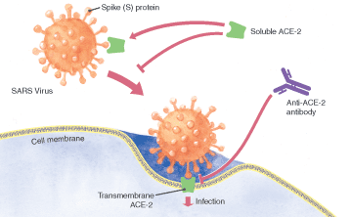
Novel CoV attachment
ACE-2 Receptors
Type 2 alveolar cells - highest
Bronchial epithelia
Tongue > buccal epithelia
Upper Intestinal epithelia
Myocardial cells
Kidney proximal tubule cells
Bladder urothelial cells
SARS-CoV-2 binds to ACE-2 Receptor 10-20x more strongly than SARS-CoV
Question of ADEs (Antibody Dependent Enhancement)
Antibodies can create a backdoor enhancement for viral replication
Implications on viral replication and vaccine development safety
https://www.nature.com/articles/s41368-020-0074-x
https://jvi.asm.org/content/94/5/e02015-19

Slide 5
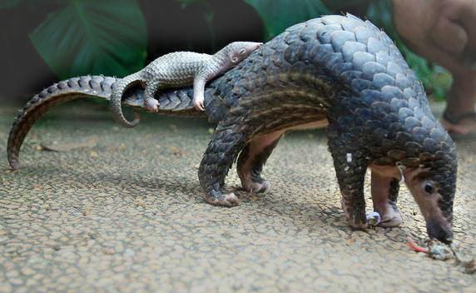
SARS-Cov-2 origin
Bat to a mammal (pangolin?) to human in Nov/Dec 2019
Pangolins used in Chinese medicine
Probable link to seafood/exotic animal market
Other plausible theory:
Wuhan Level 4 Biohazard lab experimental
animals sold for human consumption

Slide 6
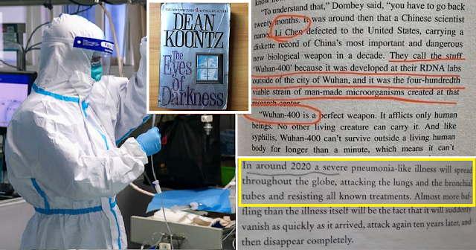
Myth 3: COVID-19 was predicted in 1981
False
…but really eerie coincidence
Notes:
Published 39 years ago.

Slide 7
Cormorbidities and Risk Conditions
Age
HTN
Diabetes
Coronary Heart Disease
Hep B
Cerebrovascular Disease
COPD
Cancer
Children and pregnant women seem to do okay

Slide 8
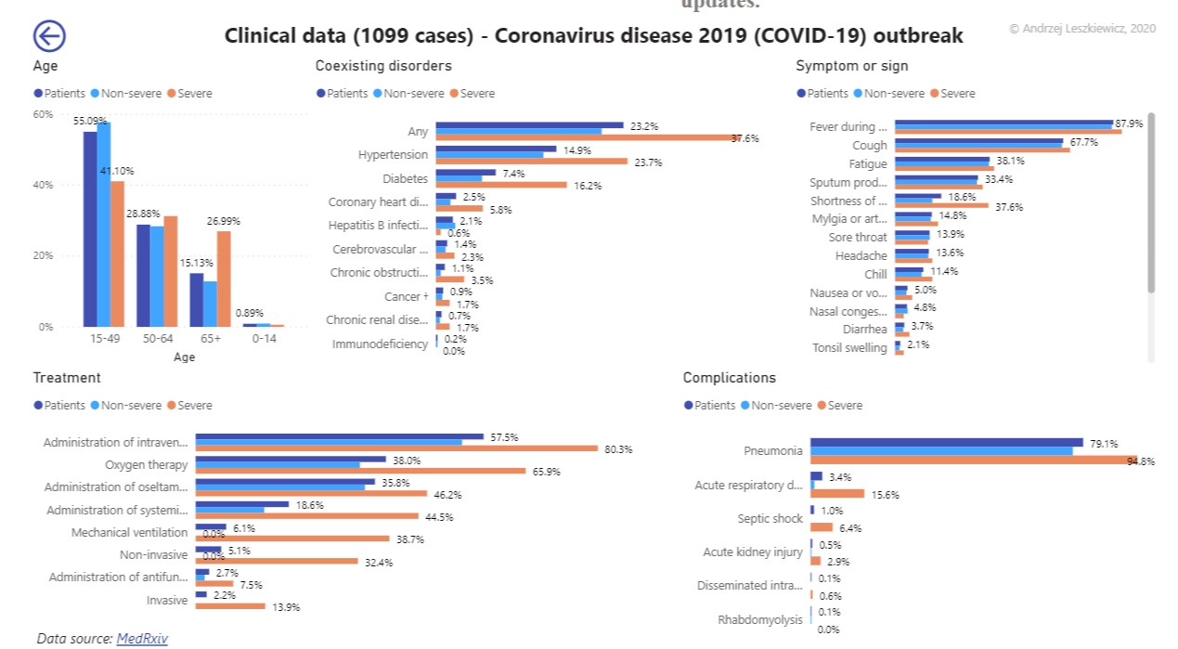
https://avatorl.org/covid-19/?page=ClinicalData1099

Slide 9
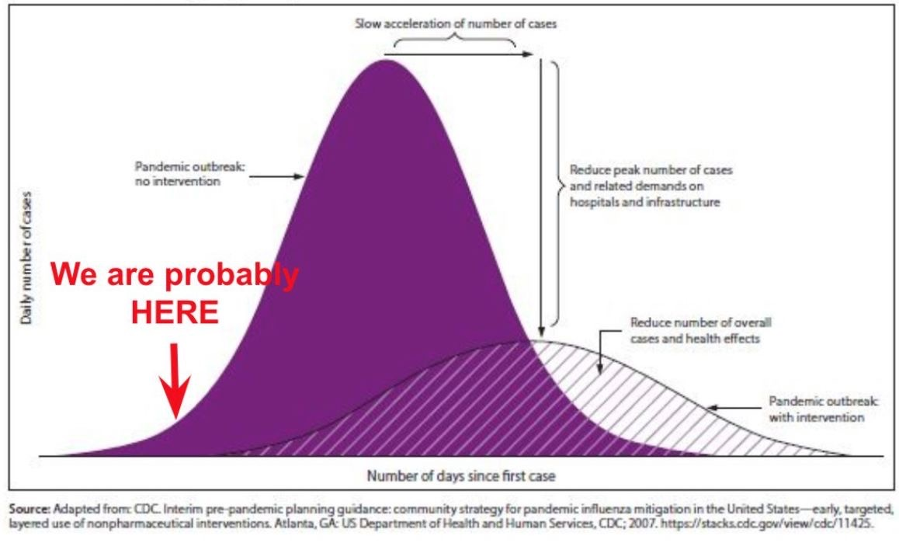
We MUST #FlattenTheCurve

Slide 10
